Slide 1

Innovative Retail & Charitable Support Solution:
Integrating Advanced Retail Technology with Community Impact
By Team HackGPT

Slide 2

Meet the Team
Jonathan Chacko
Role: Team Lead / Software Architect
Expertise: Python, Java, AI integration
Contribution: Oversees project architecture and integration of AI modules
Parv Arora
Role: AI & Data Specialist
Expertise: Python, Machine Learning, SQL, AWS
Contribution: Develops predictive analytics and data-driven insights
Raj Singh
Role: Full-Stack & Systems Integration Expert
Expertise: C#, Java, Angular, .NET, Microservices
Contribution: Integrates front-end dashboards with back-end systems
Fawad Arshad
Role: Embedded & Backend Developer
Expertise: C++, Express, Python, AWS, Docker
Contribution: Focuses on hardware-software interfacing and real-time communication
Vishal Saini
Role: AI/ML & Deployment Specialist
Expertise: Python, Rust, TensorFlow, PyTorch, AWS, Docker
Contribution: Leads model training, predictive analytics, and containerization

Slide 3

Project Dual Mission
1 Innovative Retail Technology
Integration of advanced user interfaces and real-time analytics enhances customer engagement and operational efficiency in retail environments.
2 Community Impact Focus
Data-driven strategies facilitate food donations, reducing waste while supporting local food banks and fostering community responsibility.
3 Sustainable Business Model
The dual mission promotes collaboration between retailers and charities, creating a sustainable framework that benefits both businesses and the community.

Slide 4
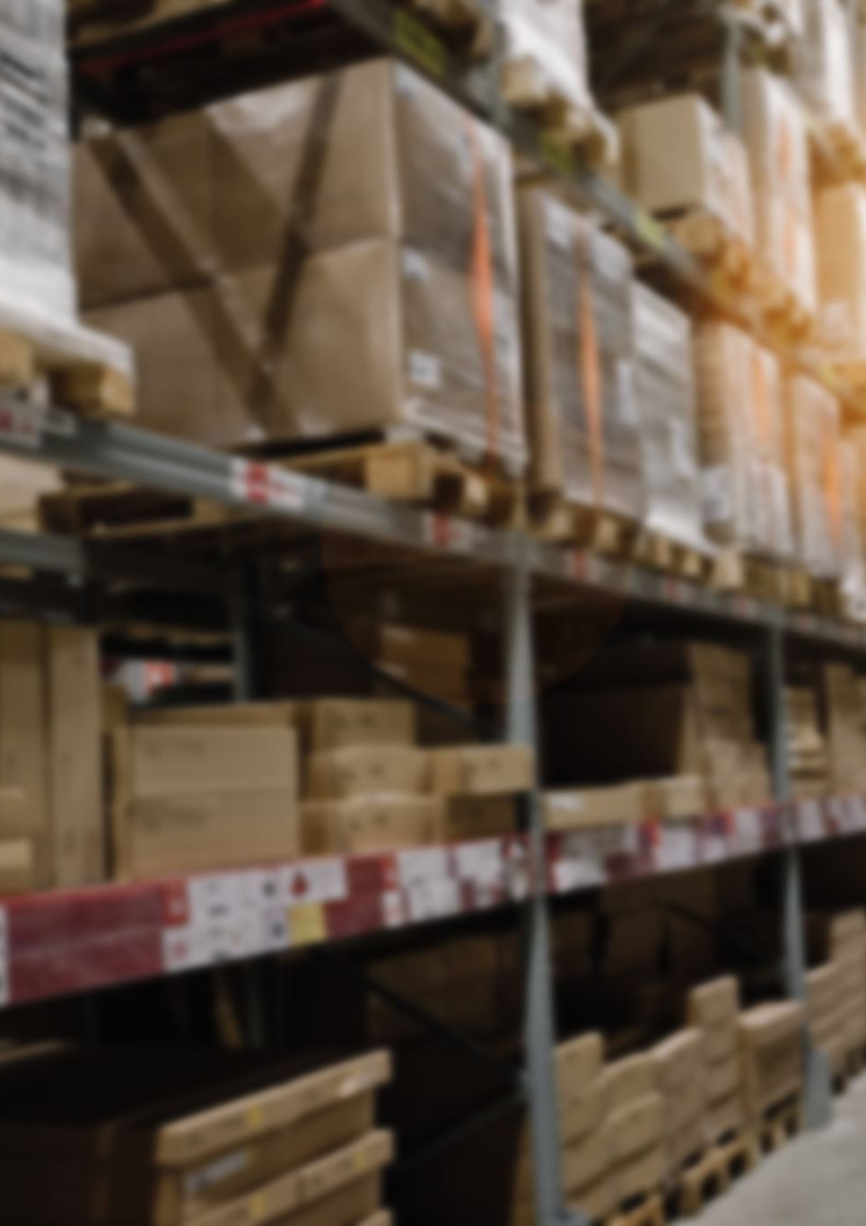
The Problem We’re Solving
Operational Inefficiencies: Traditional POS systems lack predictive analytics, leading to mismanaged inventory
Suboptimal Shopper Experience: Difficulty in navigation and product discovery in large retail spaces
Resource Waste: Excess inventory and near-expiry items are discarded rather than redirected
Siloed Operations: Independent store operations without centralized data sharing hinder optimal resource allocation

Slide 5
Our Solution
We are developing an innovative retail solution designed to address these challenges, transforming operations and enhancing customer satisfaction.
Real-Time Analytics: Predictive insights to optimize inventory management and reduce operational inefficiencies.
Enhanced Customer Experience: Smart navigation tools for quicker product location and improved shopping satisfaction.
Waste Reduction: Automated identification of surplus and near-expiry products with donation recommendations.
Social Impact: Partnering with food banks and charities to repurpose excess inventory, combating food insecurity.
A Smarter Retail Experience with a Stronger Community Focus.

Slide 6
Domain, Industry & Key Stakeholders
Retail and Community Synergy
The project integrates retail operations with community support initiatives, enhancing customer experiences while addressing food waste and insecurity through innovative technology and strategic partnerships.
Stakeholder Collaboration Importance
Engaging diverse stakeholders, including operational staff, management, and community partners, is essential for maximizing the project's impact on both retail efficiency and social responsibility.

Slide 7
Domain and Key Stakeholders
Domain Overview: Our solution operates at the intersection of retail innovation and social impact, targeting grocery stores, specialty food retailers, and community-driven markets. By embracing technology, these businesses streamline operations and enhance customer engagement.
Key Stakeholders:
Operational Staff: Stock clerks, cashiers, and logistics administrators benefit from automated alerts and centralized inventory management.
Management: Store managers and inventory control teams access real-time analytics for proactive decision-making and efficient resource management.
Shoppers: End users enjoy a seamless shopping experience with in-cart tablets providing product suggestions and store navigation.
Community Partners: Food banks and charities receive real-time notifications for surplus products, ensuring timely donations and reducing waste.

Slide 8
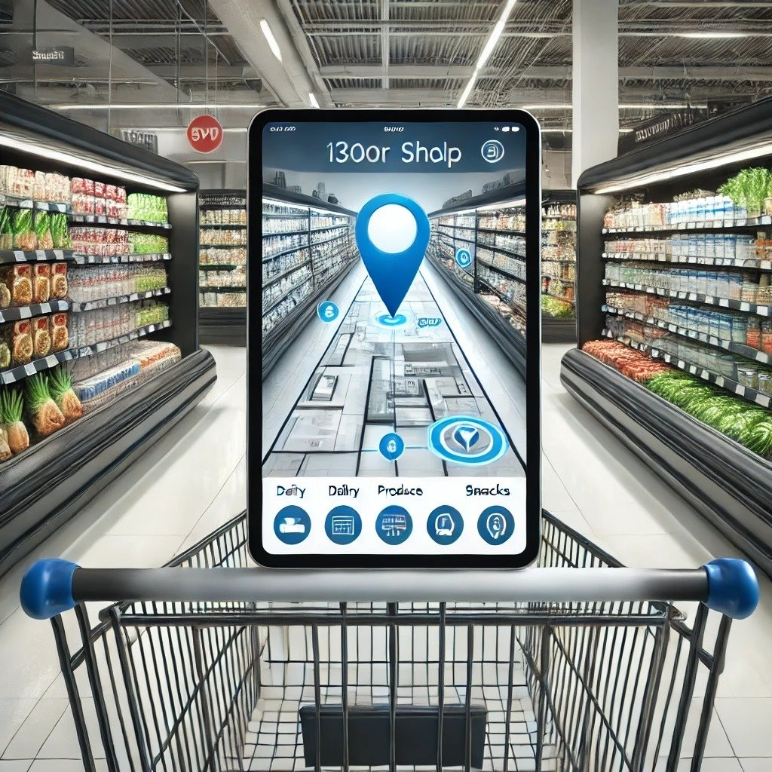
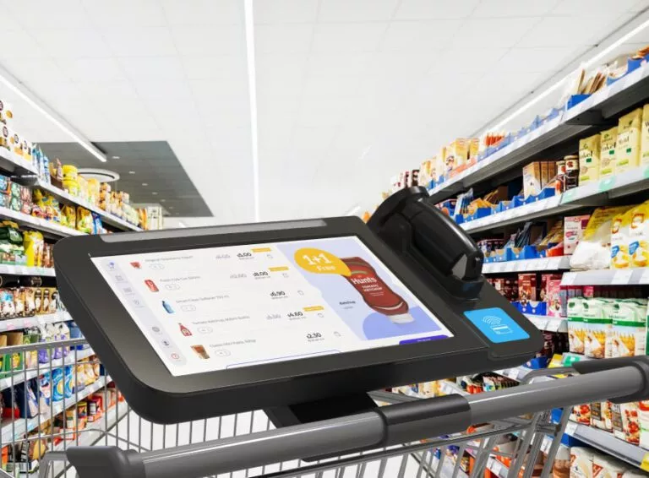
Demo Concept

Slide 9
Technologies
Software:
Use of established web technologies (HTML, CSS, JS) for UIs
Python libraries (TensorFlow, etc.) for analytics.
Hardware:
Affordable embedded systems integrated with off-the-shelf components.
IPS Tracking Systems created by using
ESP32-UWB3000
Wi-Fi Signal Access Triangulations (Cheaper Alternative)
System Integration:
Centralized architecture that connects real-time hardware inputs with cloud-based analytics and dashboards.

Slide 10
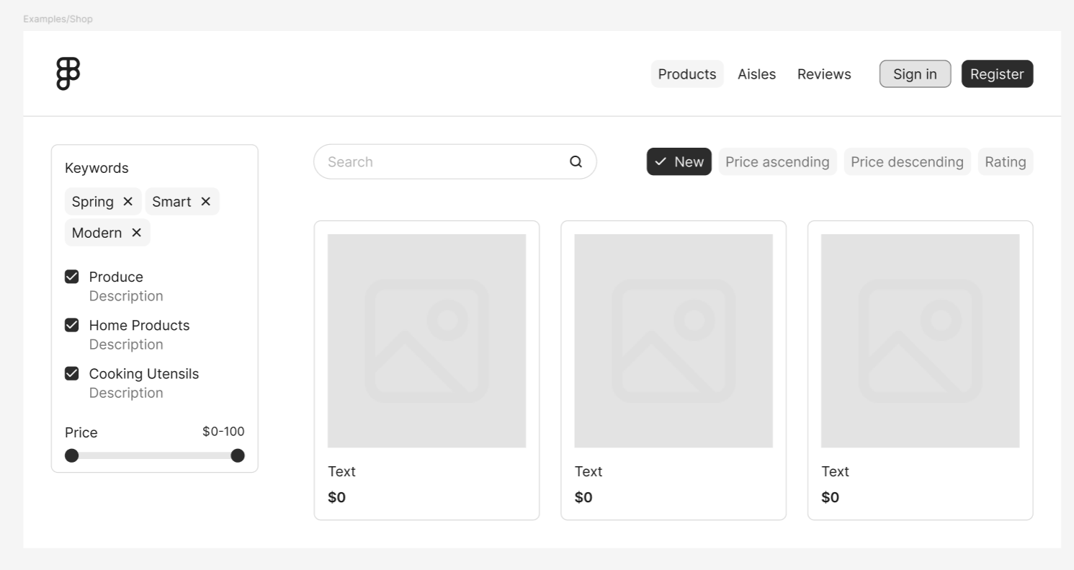
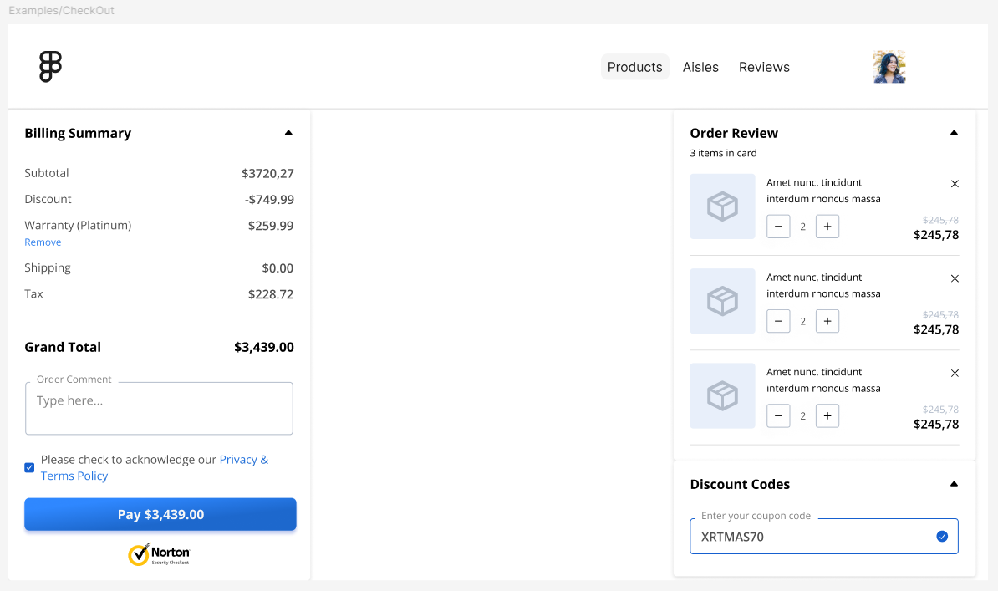
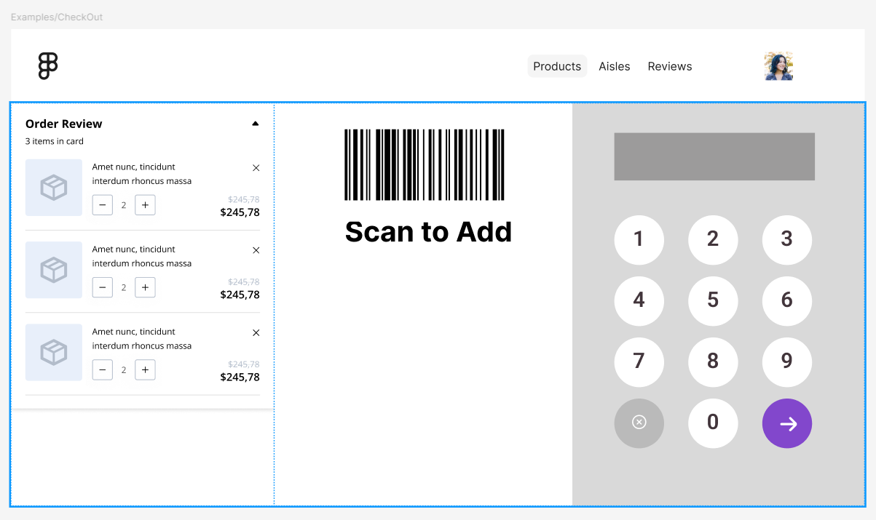
Demo Concept

Slide 11

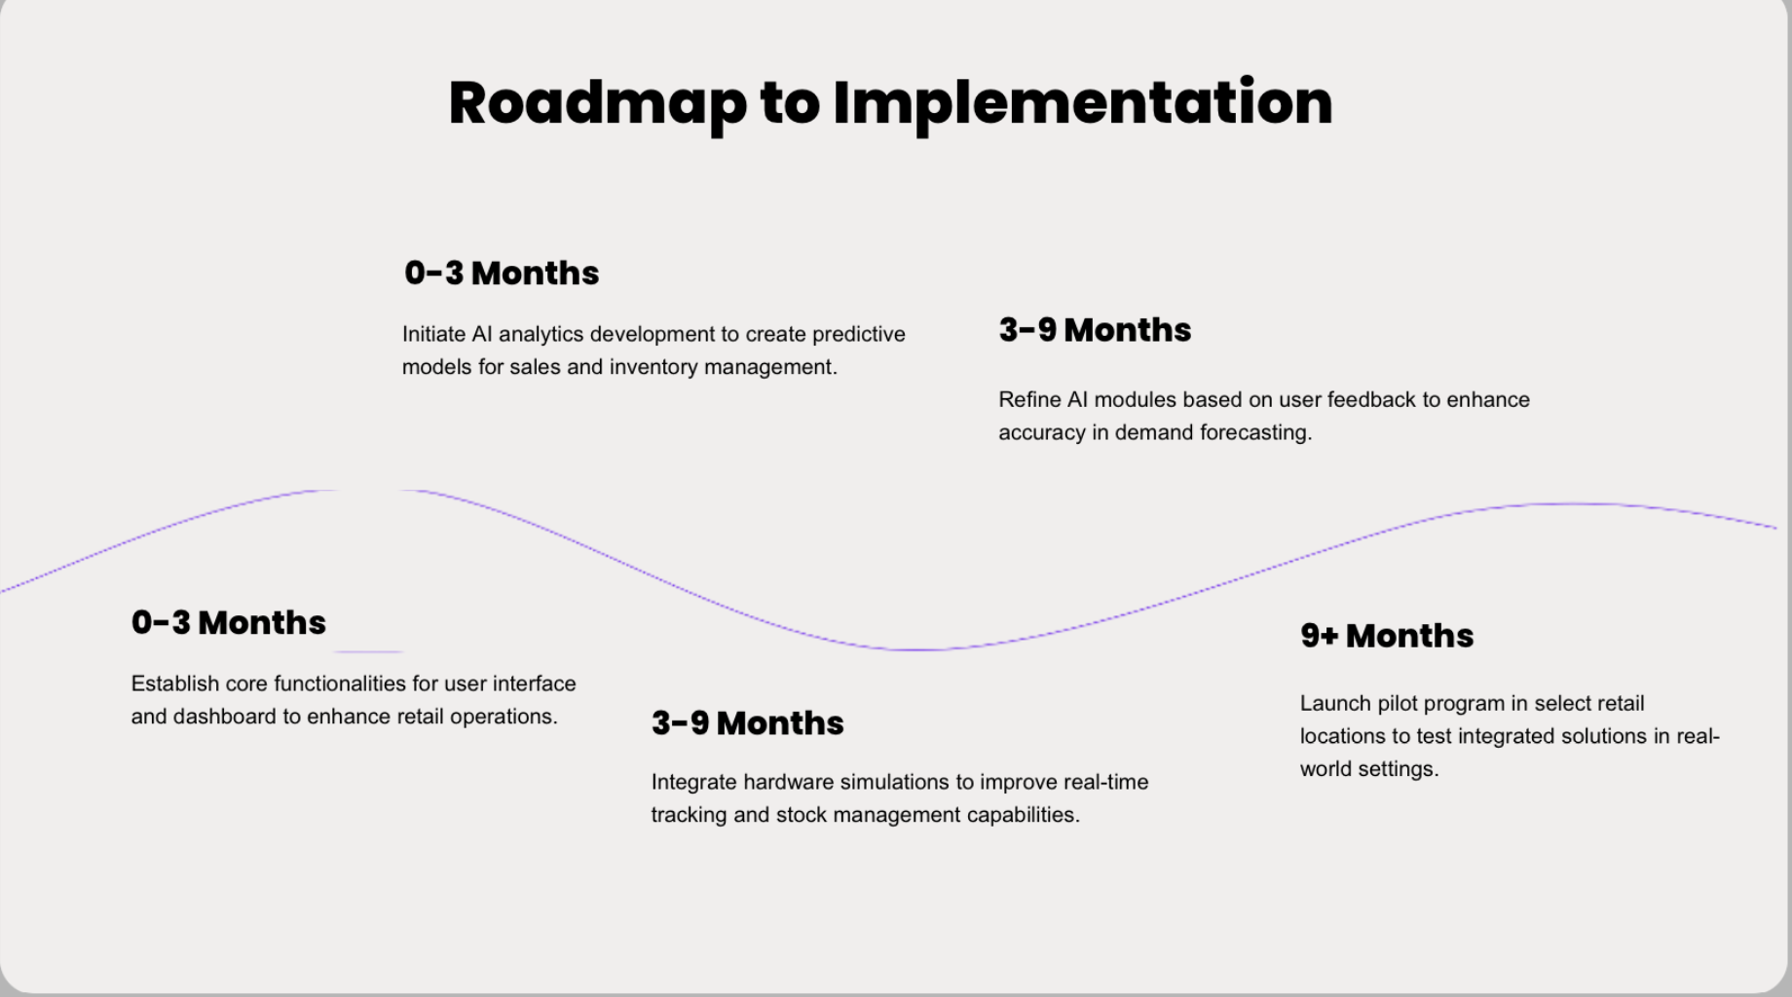
Roadmap to Implementation
Short-Term (0-3 months):
Develop core functionalities (cart UI, basic dashboard, initial AI analytics)
Mid-Term (3-9 months):
Integrate hardware simulations (IPS, barcode scanners)
Refine AI modules based on user feedback
Long-Term (9+ months):
Pilot implementation in select retail locations
Iterative improvements based on stakeholder feedback and performance data

Slide 12
Feasibility & Viability
Technical Framework Strength
Utilizes proven technologies ensuring
reliability and scalability for future
enhancements.
User-Centric Design
Focuses on intuitive interfaces to minimize
training and improve operational efficiency.
Cost-Effective Solutions
Predictive analytics reduce waste and
optimize inventory, enhancing profitability
and community support.

Slide 13

Real-World Impact
For Shoppers:
Interactive cart interface that guides product selection
Smart recommendations based on current stock and seasonal trends
For Managers:
Centralized dashboard providing real-time inventory insights
Automated stock alerts and donation triggers for near-expiry products

Slide 14
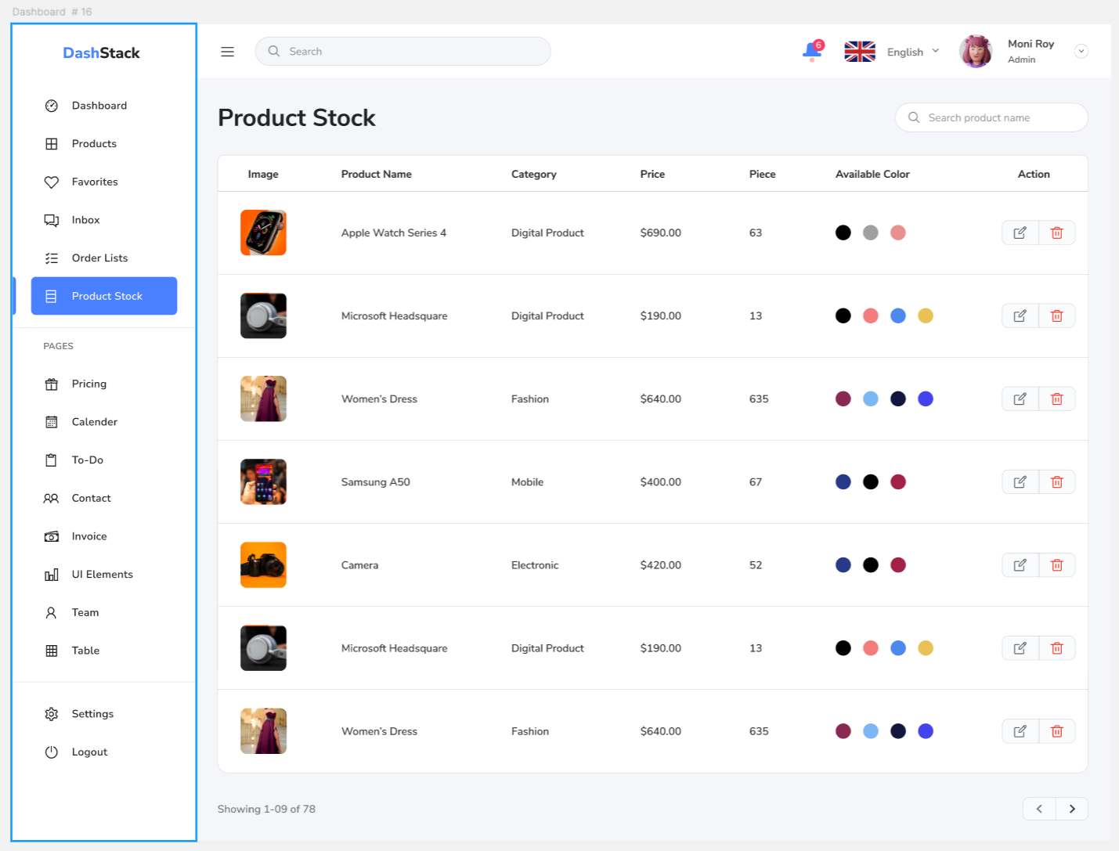
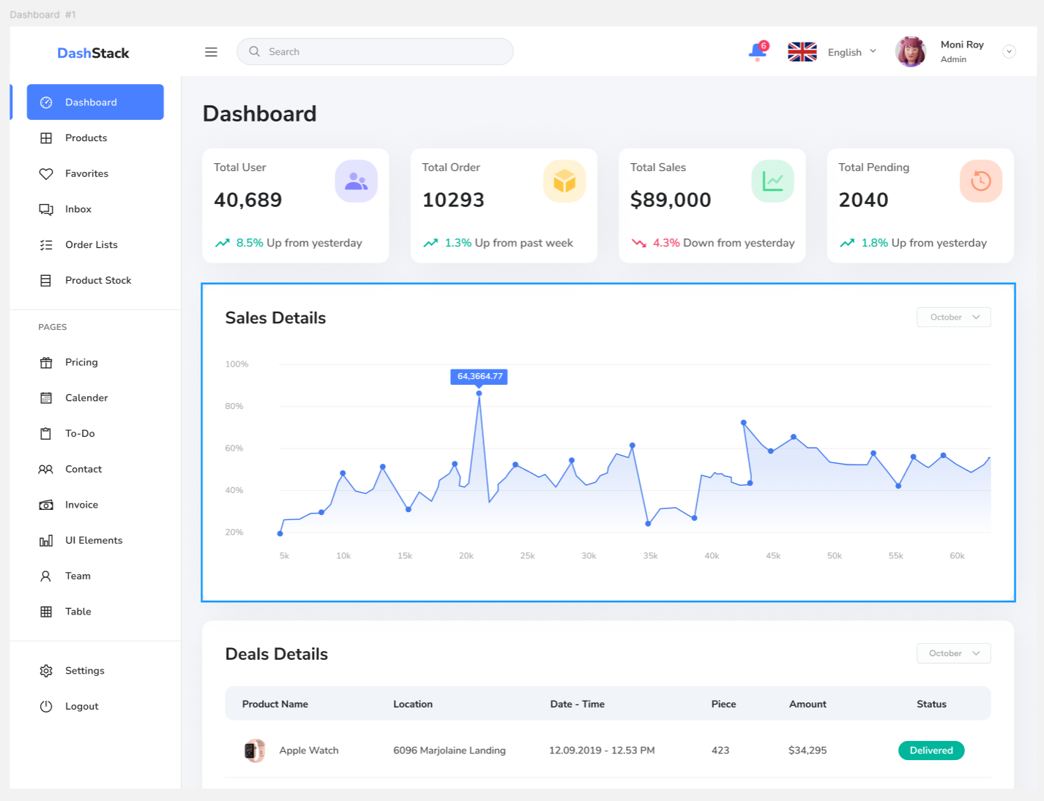
Demo Concept

Slide 15


Conclusion & Call to Action
Dual Mission Impact
The Project Canvas effectively combines retail innovation with social responsibility, addressing food waste while enhancing operational efficiency, creating a sustainable model for community engagement and support.
Stakeholder Engagement Importance
Active participation from stakeholders is crucial for refining the initiative, ensuring that diverse insights shape the project’s development and enhance its effectiveness in real-world applications.
Collaborative Future Vision
A call to action for collaboration invites stakeholders to contribute ideas and resources, fostering a shared commitment to transforming retail practices and supporting community welfare through innovative solutions.

Slide 16
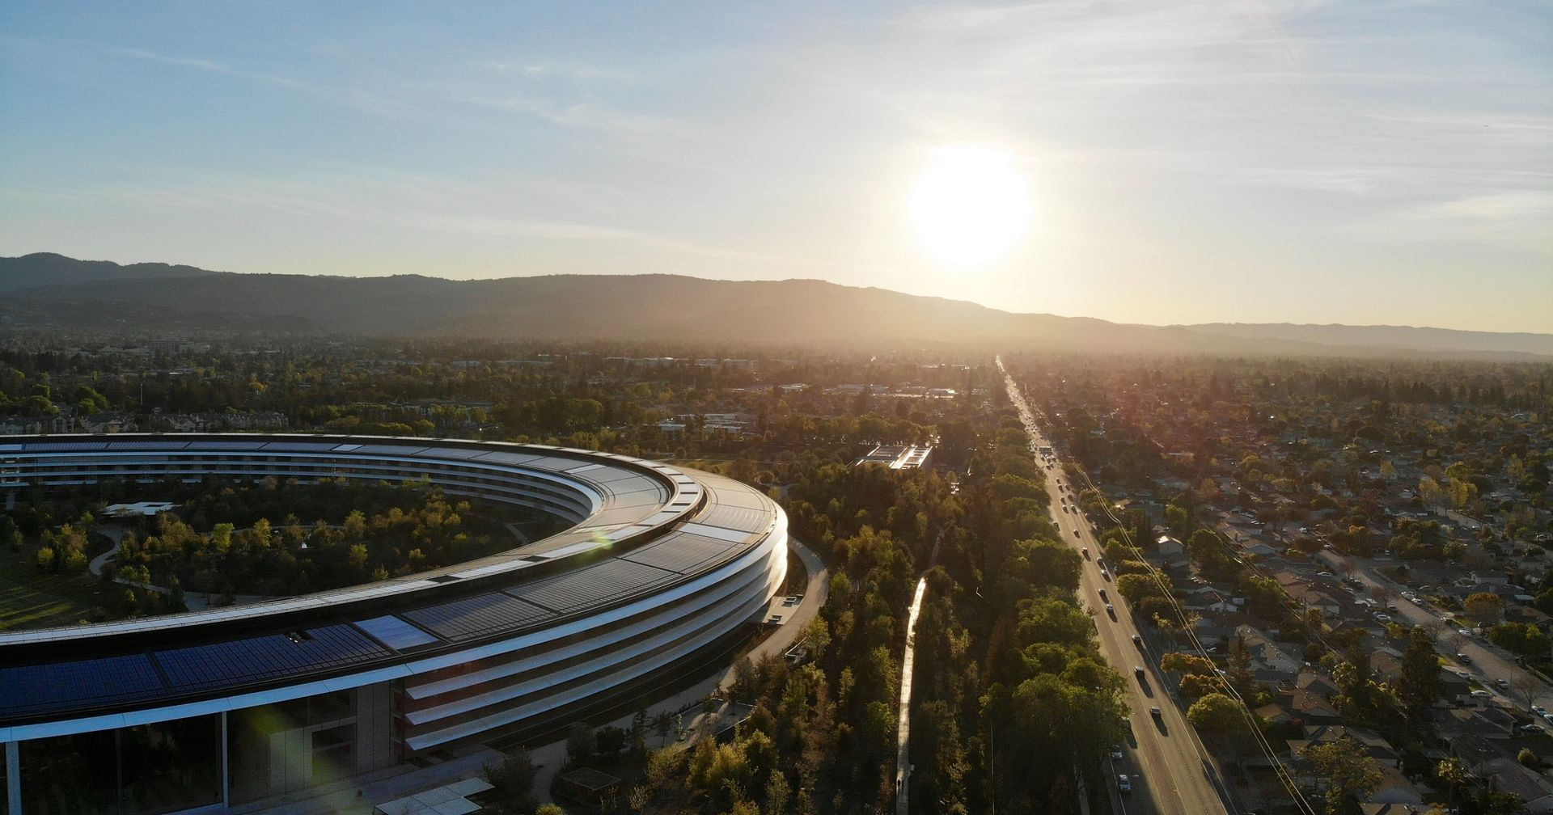
Thank You
Jonathan Chacko
Email:
Parv Arora
Email:
Raj Singh
Email:
Fawad Arshad
Email:
Vishal Saini
Email:

